Slide 1

A presentation on Sales of summer clothes In e-commerce Portal (wish.com)
BY
Jayanta Das
Santanu Ghosh
Arijit Mukherjee

Slide 2
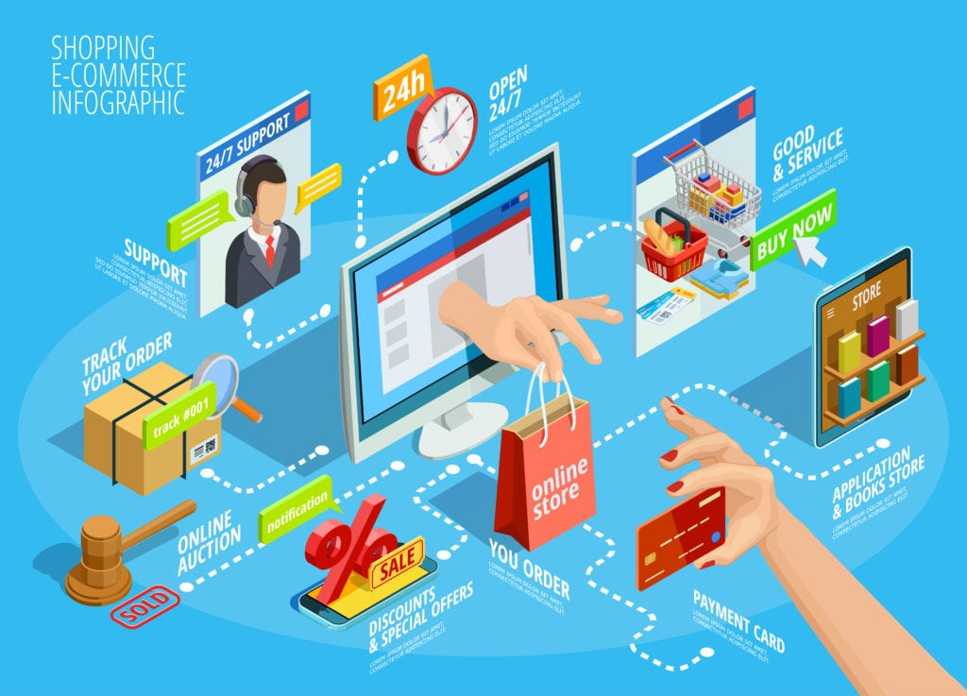
What is E-COMMERCE?
Commonly knows as Electronic Marketing.
It consists of buying and selling goods and services over an electronic Systems Such as internet and other computer systems.
E-Commerce is about purchasing, selling, exchanging goods and services over computer Networks (internet) through which transaction or terms of sales are performed Electronically

Slide 3

Terminology to know?
B2B-This is business to business ,or selling the products to another business
B2C-Business to Consumer or selling, directly to the product. Our dataset is all about B2c.

Slide 4
Benefits of E-commerce
Extra source of Revenue
An additional channel of distribution ,especially for consumers who live in very far from fashion houses
No overhead from rent, etc. or operating costs
Faster transactions
Consumer can see new collection faster

Slide 5
Disadvantages of ecommerce
High set-up costs
Charges apply for online transaction
Risk of fraudulent trade
Internet is volatile
Customers can’t try on the clothes, etc

Slide 6
Introduction
This dataset contains product listings as well as products ratings and sales performance, which you would not find in other datasets. With this, you can finally start to look for correlations and patterns regarding the success of a product and the various components
E-commerce platform becomes reality of disruption that changes the form of physical transactions into online (despite social media), especially in the developing world. Using this platform, entrepreneurs can take advantage of it in business optimization, accelerating business development, access to new market segments, etc. But the question likely to appear is about how to do so?

Slide 7
Objective
Understanding how well a product is going to sell that is published on the E-Commerce platform Wish using Machine Learning.

Slide 8
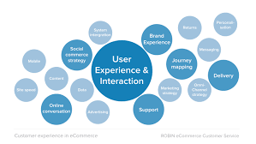
Context
In this notebook, I used Wish summer clothes sales dataset that contain a lot of information we can dig for and defined Units Sold feature as a key metric that measure market performance by each product/merchant. Firstly, we build hypothesis variable that affect Units Sold

Slide 9
Content
This dataset contains product listings as well as products ratings and sales performance, which you would not find in other datasets
With this, you can finally start to look for correlations and patterns regarding the success of a product and the various components

Slide 10
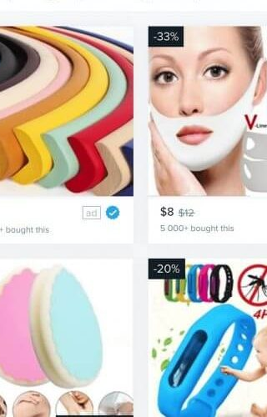
Inspiration
How about trying to validate the established idea of human sensitiveness to price drops ? (discounted price compared to original retail price)
You may look for top categories of products so that you know what sells best
Do bad products sell ? How about the relationship between the quality of a product (ratings) and its success ? Does the price factor into this?

Slide 11
Collection Methodology
The data comes from the Wish platform. Basically, the products listed in the dataset are those that would appear if you type "summer" in the search field of the platform.
You can browse the Wish website or app to get a feel of the type of information you can get from there and how they are presented. This might give you some ideas and a better understanding.

Slide 12
Features and Columns
The data was scraped in the French localization (hence some non-ascii latin characters such as « é » and « à ») in the title column.
The title_orig on the other hand contains the original title (the base title) that is displayed by default. When a translation is provided by the seller, it appears in the title column. When the title and title_orig columns are the same, it generally means that the seller did not specify a translation that would be displayed to users with French settings.

Slide 13
Data Dictionary
title: Title for localized for European countries. May be the same as title_orig if the seller did not offer a translation.
price: price you would pay to get the product
title_orig: Original English title of the product
retail_price: reference price for similar articles on the market, or in other stores/places. Used by the seller to indicate a regular value or the price before discount.
currency_buyer: currency of the prices
units_sold: Number of units sold. Lower bound approximation by steps
uses_ad_boosts: Whether the seller paid to boost his product within the platform (highlighting, better placement or whatever)
rating: Mean product rating
rating_count: Total number of ratings of the product
rating_five_count: Number of 5-star ratings (the same as four three two one count
badges_count: Number of badges the product or the seller have
badge_local_product:. A badge that denotes the product is a local product. Conditions may vary (being produced locally, or something else). Some people may prefer buying local products rather than. 1 means Yes, has the badge.
badge_product_quality: is quality product
badge_fast_shipping: support fast shipping
tags: tags set by the seller
product_color: Product's main color

Slide 14
product_variation_size_id: One of the available size variation for this product
product_variation_inventory: Inventory the seller has. Max allowed quantity is 50
shipping_option_name
shipping_option_price: shipping price
shipping_is_express: whether the shipping is express or not.
countries_shipped_to: Number of countries this product is shipped to. Sellers may choose to limit where they ship a product to
inventory_total: Total inventory for all the product's variations (size/color variations for instance)
has_urgency_banner: whether there was an urgency banner with an urgency
urgency_text: A text banner that appear over some products in the search results.
merchant_title: Merchant's displayed name (show in the UI as the seller's shop name)
merchant_name: Merchant's canonical name. A name not shown publicly. Used by the website under the hood as a canonical name. Easier to process since all lowercase without white space
merchant_rating_count: Number of ratings of this seller
merchant_rating: merchant's rating
merchant_profile_picture: Custom profile picture of the seller (if the seller has one). Empty otherwise.

Slide 15
Features selection
Based on Domain knowledge selected most important features are price, retail price, rating, rating count ,product color and product variation size.
From EDA the selected features are badges counts , badges product quality, shipping option price ,country, merchant rating, merchant has profile pictures ,and merchant has no profile pictures.
Rest of the features are redundant and making noise we don’t need those features and dropped it.

Slide 16
Model Selection and accuracy
Random Forests Classifier gives us a really good accuracy of 96% on the test set. But let's check this with k fold cross validation and see if there is any overfitting. We can also checkout the important features (columns) in this dataset using the RandomForestClassifier as decision trees are one of the best ways to do so.

Slide 17
Conclusion
The uses of ad boosts does not have any effect on number of units sold and might lose revenue from running ads
More accurate clinical analysis can be done if the exact number of units_sold is known
Higher ratings means higher units sold
Product quality badges seems to increase the success of the products.

Slide 18


Slide 19


